Slide 1
Forwarding Loop Attacks and counter measures in Content Centric Networks
By
Sarat Velijala
Adviser: Dr. Yong Guan
Dr. Manimaran Govindarasu
Dr. Akhilesh Tyagi

Slide 2
TOPICS COVERED
Why CCN?
CCN – data structures
CCN – Forwarding strategy
CCN- Flooding strategy
Major Attacks in CCN- Interest Flooding Attack
Forwarding loop attacks
(1) Scenario 1: Static CCN
(2) Scenario 2: Mobile and Infrastructure CCN
Detection and Mitigation Techniques
Performance Evaluation

Slide 3

The Internet of Things is the idea of everyday objects with network connectivity.
So rather than just phones and computers being connected to the internet it would also be cars, washing machines, thermostats, televisions, street lights and just about anything else you can think of.

Slide 4
Information centric networking in iot
Basic Principles in Information Centric Networks (ICN)
Data is delocalized
Need not be retrieved via an end-to-end transport stream.
Instead uses hop-hop by replication
In-network caching
All these factors relax the demand for continued connectivity
Such perspectives, based on ICN, were recently mentioned as a potential alternative networking solution for the IoT .

Slide 5
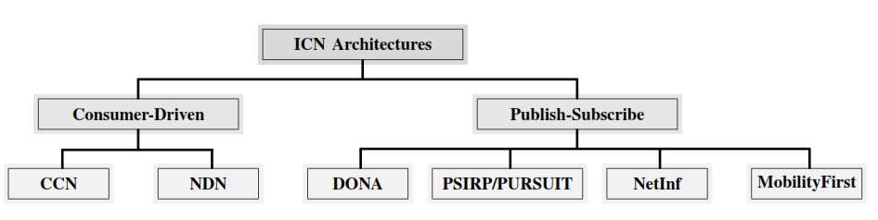
ICN Categories

Slide 6
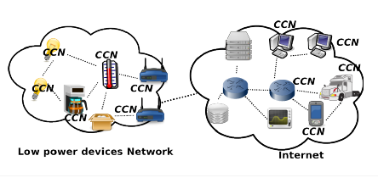
Information centric networking in iot

Slide 7
CONTENT CENTRIC NETWORKS

Slide 8
CCN is based on a few simple key tenets.
Access content by name, not machine address
Networking and communications are better served by using names to access information as opposed to using machine addresses.
Packets have no source or destination addresses, the name identiﬁes a request and response. Secure the content, not the connection
Security must be the foundation of any network architecture
Securing the data is more important (and useful) than securing the connections. Security does not rely on secure communication end-points or secure communication channels.
Add computing and memory into the network
Computation and memory continue to decline in cost, making it feasible to add computation and memory to routers and, as a result, maintain state and object stores. CCN may cache content throughout the network essentially creating a fully-managed peer-to-peer network without losing control of content.

Slide 9
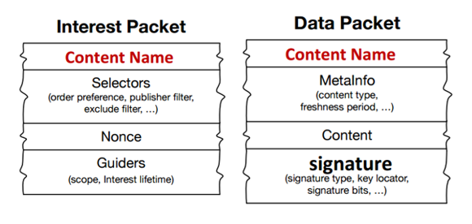
CCN Messages

Slide 10
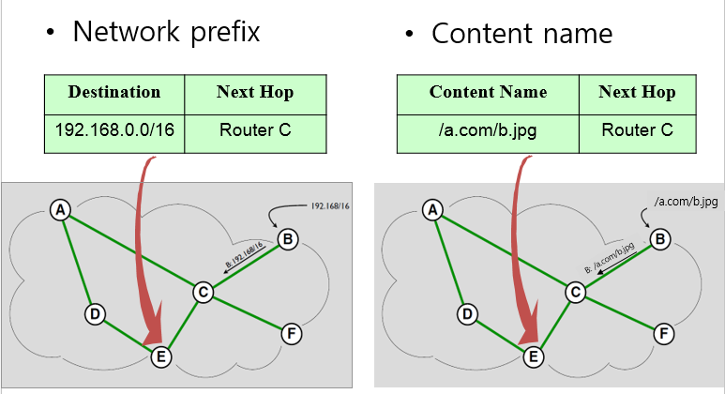
IP networking vs. CN

Slide 11
cCN DaTa Structures
A CCN node has three main data structures:
1) Content Store (buffer memory) (CS)
2) Forwarding Information Base (FIB)
3) Pending Interest Table (PIT)

Slide 12
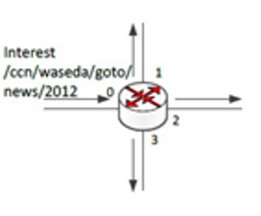
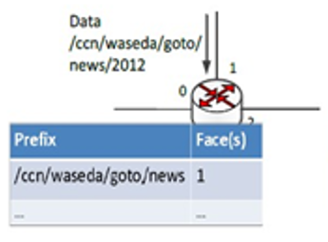
(A) Arrival of New Interest (FLOODING STRATEGY)
(b)Arrival of the First Data Packet

Slide 13
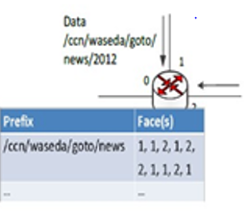
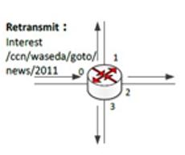
(c) Arrival of Data Packet with the Same Prefix
(D) Interest forwarding

Slide 14
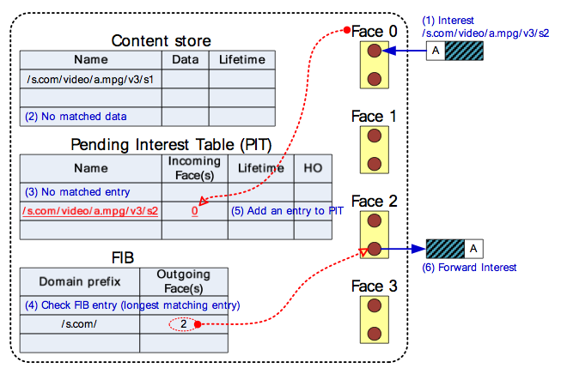
Forwarding strategy when an interest packet is Received

Slide 15
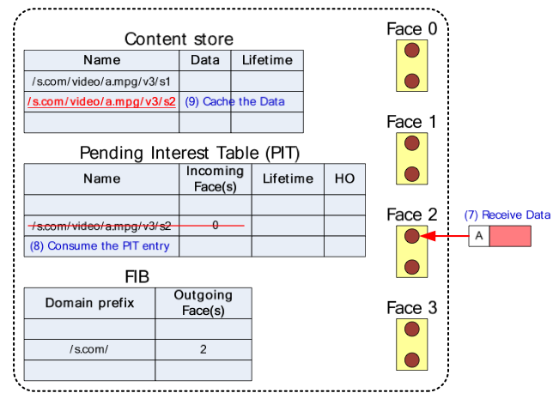
Forwarding strategy when CONTENT OBJECT is Received

Slide 16
Arrival of New Interest
At the initial stage, the FIB on each CCN node is empty. An incoming Interest packet at Face 0 is propagated to all Faces (1, 2, and 3) except the incoming Face 0. This is an initial flooding.
Arrival of the First Data Packet
When the first Data packet arrives, the corresponding FIB entry is created. The prefix of the Data name is stored in the Prefix field and the arrival face of the Data is recorded in the Face(s) field, which can maintain N maximum elements (faces).
(c) Arrival of Data Packet with the Same Prefix
When there is the second Data packet with the same prefix as an existing packet in the FIB, the arrival face will be added to the corresponding Face(s). If N faces are already stored in the set of Face(s), a FIFO operation is performed. That means that the first oldest arrival face will be deleted.
Interest Forwarding Principle
When a new Interest packet arrives that matches Prefix entries in the FIB, Interest forwarding is performed by selecting one face among the elements in Face(s) according to the occurrence ratio of the faces. That is, the most successful face is selected. Since the FIB can maintain at most N faces, the learning mechanism adjusts the face selection according to the recent data retrievals. In the case of link failure or packet loss, Data does not return in time; therefore, the data requester or consumer returns to step [a], flooding the Interest to all available connected faces to discover a working path quickly.

Slide 17
Lifetime Strategy
CASE 1: If a new, similar, Interest comes from the same previous hop then:
• If the new Lifetime would extend PIT entry lifetime, update the PIT entry to the max of (old Lifetime, new Lifetime) and forward.
• if the new Lifetime would not extend PIT entry, forward (no PIT update required).
CASE 2: If a new, similar, Interest comes from a different previous hop then:
• If the new Lifetime would not extend the PIT entry, update PIT with new previous hop and don’t forward.
• If the new Lifetime would extend the PIT entry, update PIT entry to the max of (old Lifetime, new Lifetime), add the new previous hop, and forward.

Slide 18
Major Attacks in CCN-Interest flooding attacks

Slide 19
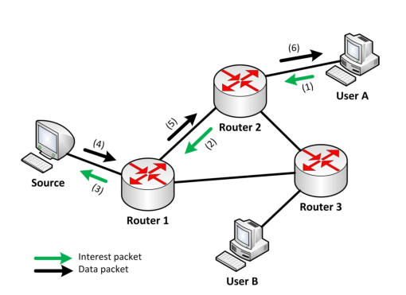
Basic ccn communication model

Slide 20
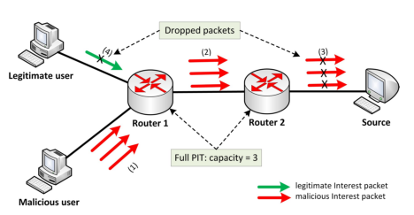
Interest flooding attack in ccn

Slide 21
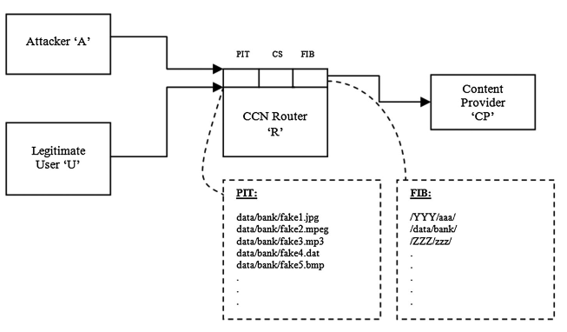
ifa-mechanism

Slide 22
Forwarding loop attacks in CCN

Slide 23
Malicious customers of nodes (Consumers, Publishers or Routers) can deliberately manipulate the forwarding to create forwarding loops inside CCNs.
Forwarding loops can cause CCNs to process one client request repetitively or even indefinitely.
The consequent amplification effect allows malicious customers to launch, with little resources and cost, resource-consuming DoS attacks (Interest Flooding Attacks) against CCNs.

Slide 24
In this thesis, we have identified approaches to create forwarding loops in the following kinds of CCN network systems:
A) Static Networks
B) Mobile-Infrastructure
C) Mobile-ad-hoc network
The process of Forwarding Loop is described in three main stages at each network system:
(i) Identification of the loop
(ii) Creation and Sustenance of the loop
(iii) Exploitation of the loop

Slide 25
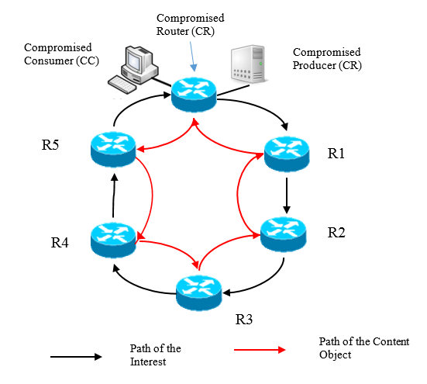
Forwarding Loops in Static CCN with one compromised router

Slide 26
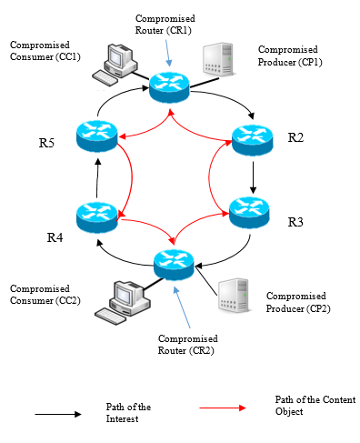
Forwarding Loops in Static CCN with two compromised routers

Slide 27
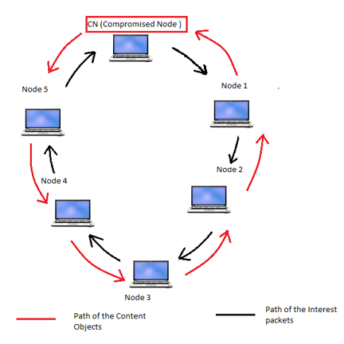
Forwarding Loops in Mobile Ad hoc CCN with one CR

Slide 28

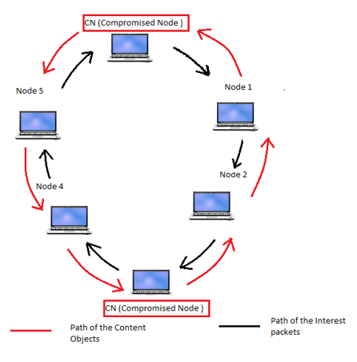

Slide 29
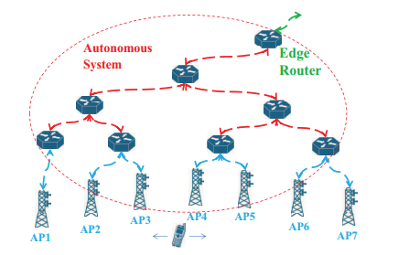
Intra-domain Forwarding Loop in mobile infrastructure CCN

Slide 30
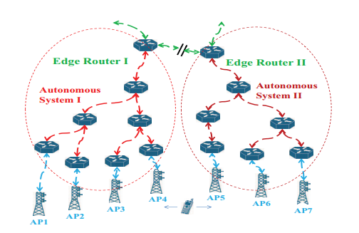
Inter-domain Forwarding Loop in mobile infrastructure CCN

Slide 31
Detection and mitigation
(A) Static CCN
Threshold Based Mitigation strategy for IFA
Three Phases:
Attack detection phase: the edge router detects anomalous user behavior and identiﬁes the user either as suspicious or as an attacker.
Rate reduction and blocking phase: the edge router reduces the data rate of suspicious users and blocks the attackers.
Attack notiﬁcation phase: the edge router notiﬁes other edge routers about the detected attack
.

Slide 32
Attack detection phase
Every node evaluates the assigned a N-exp value( the number of expired PIT entries per unit time) for every user activities
Two thresholds are used to classify users into:
(a) Legitimate
(b) Suspicious (possible attackers)
(c) Malicious (attackers).
If the N-exp < T-Low , user is considered legitimate
T-Low < N-exp <T-High . user is considered suspicious
N-exp > T-High, user is considered malicious.

Slide 33
Rate reduction and blocking phase: During this phase, any user that has been classiﬁed as malicious, will be blocked, whereas the suspicious users will receive reduced data rate
Attack notiﬁcation phase: If an edge router detects an ongoing attack, after blocking this user, it will notify other routers about the identity of the malicious user, by sending the attack notiﬁcation packet

Slide 34
Detection and mitigation contd.
(B) Ad-Hoc CCN
The first step in any successful attack requires the node to be part of that network.
As there is no constraint in joining the network, malicious node can join and disrupts the network .
Node ID/ Router ID fields
One of the main reasons for the creation of the forwarding loop is the re-transmission of the Interest back to the to the compromised node. This can be avoided by the implelentation of a Router-ID field. Using a Router-ID. along with the Interest packet. R-IDs are assigned when a node joins the Ad-Hoc network and identifies itself to the nearby node by sending a PROBE request and every node is aware of the R-IDs of its one-hop neighbors. When forwarding the Interest for the unknown content, a particular node checks the R-ID of the Interest packet. If the R-ID matches to its one-hop neighbors it drops the packet, thus avoiding the formation of the loop.

Slide 35
Detection and mitigation contd.
(C) INFRASTRUCURE CCN
Producer Node registers it’s prefix on a nearby access point to the network
Same node can register as a consumer node on another Access Point
Making sure the Handoff process is complete and no node registers itself as both a producer and a consumer.
Usage of Node-ID in the interest packet is another way of mitigating the flooding attacks in Infrastructure CCN

Slide 36
PERFORMANCE EVALUATION

Slide 37
ndnSIM Simulation Software for CCN
The fundamental departure of the CCN communication paradigm from the IP principles requires extensive evaluation through experimentation, and simulation is a necessary tool to enable the experimentation at scale. For this purpose, we rely on the open source simulation software ndnSIM.
We consider a mesh network in Matix representation of 5X5, with 25 (18 edge routers + 17 core routers). 10 Consumer Nodes and 10 Producer Nodes listening on the Edge Routers
Case 1: One CR (with a CC and CP with Loop sizes of 5,7,9,11,13,15
Case 2: 4 CRs (with 2 Looping scenarios and 1 mitigation scenario)
Packet Dropping Probabilty

Slide 38
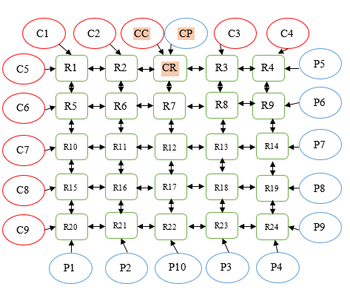
5x5 ccn grid system to evaluate the impact of Forwarding Loops in Static CCN with one compromised node (multiple Loops)

Slide 39
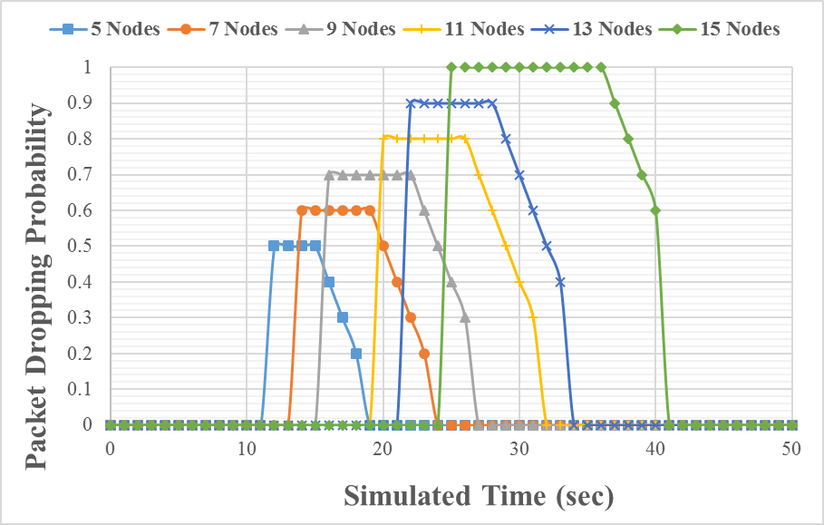
Graph depicting the Packet Dropping Probability in 5x5 matrix with multiple loops involving one cN
PIT Capacity : 250 MB
T-expiration: 500 msec

Slide 40
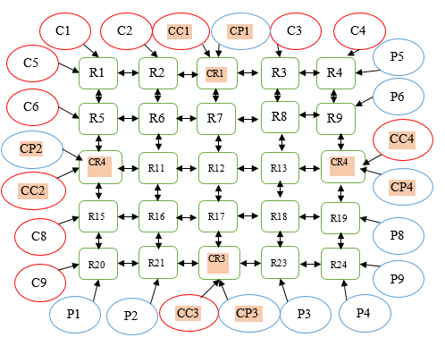
5x5 ccn grid system to evaluate the impact of Forwarding Loops in Static CCN with four compromise nodes

Slide 41
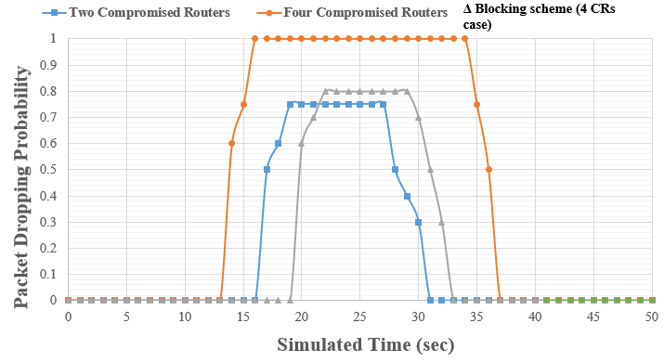
Graph depicting the Packet Dropping Probability in 5x5 matrix with two pairs of compromised nodes
PIT Capacity : 250 MB
T-expiration: 500 msec

Slide 42
Thank you! Questions?

